Slide 1






Sentimental analysis AI system
Name & Email id : YUVARAJAN VK & yuvarajanvk754@gmail.com
NM ID:au811321114034
Reg No:811321114034
Guide:(P.Raja, Master Trainer )
JJ COLLEGE OF ENGINEERING AND TECHNOLOGY
Disclaimer: The content is curated for educational purposes only.
Notes:
Slides: Prepare a short slide deck (10-12 slides) summarizing the project objectives, methodology, and key results.

Slide 2
OUTLINE
Abstract of the Project
Problem Statement
Proposed Solution
System Architecture
Live Demo of the Project
Embedded Video of Project
Conclusion
Future Scope

Slide 3


Abstract
This project examines sentiment analysis, a vital area in natural language processing that assesses the emotional tone of text, particularly in customer reviews. Utilizing techniques like VADER and the RoBERTa transformer model, the study analyzes sentiment from review datasets. The findings highlight the effectiveness of machine learning in accurately categorizing sentiment as positive, negative, or neutral, revealing differences between traditional methods and advanced models.The research identifies limitations in current methodologies and proposes future enhancements, including real-time analysis capabilities. Overall, this work contributes to the understanding of sentiment analysis and its applications in gauging public opinion.

Slide 4


Problem Statement
The rapid growth of user-generated content on social media and e-commerce platforms has made understanding public sentiment challenging. Traditional sentiment analysis methods often fail to accurately capture nuances, context, and sarcasm, leading to misinterpretations. This project aims to improve sentiment classification accuracy in customer reviews by employing advanced models like VADER and RoBERTa. By developing a robust framework, we seek to enhance insights into consumer behavior and support data-driven decision-making for businesses, addressing the limitations of conventional sentiment analysis techniques.

Slide 5
Proposed Solution
Hybrid Sentiment Analysis FrameworkVADER: Analyzes short reviews using keyword-based sentiment.RoBERTa: Evaluates longer texts, understanding context for better accuracy.
Implementation StepsData Collection: Gather and preprocess customer reviews.Performance Evaluation: Use precision, recall, and qualitative analysis.Real-Time System: Provides instant insights into customer sentiments.
Expected OutcomeEnhanced sentiment analysis accuracy.Improved business decision-making and customer engagement.

Slide 6
System Architecture
OverviewDiagram illustrating the flow of data and interactions within the system.
ComponentsData Collection Module:Gathers customer reviews from various sources (e.g., websites, APIs).Preprocessing Module:Cleans and tokenizes text data, removing noise and irrelevant information.Sentiment Analysis Module:VADER: Processes short reviews for quick sentiment scoring.RoBERTa: Analyzes longer reviews for in-depth sentiment understanding.Output Module:Generates reports and visualizations of sentiment analysis results for business insights.
Flow of InformationData flows from collection → preprocessing → sentiment analysis → output.

Slide 7
Live Demo of Project
Project OverviewDemonstration of a real-time sentiment analysis application using VADER and RoBERTa models.
FeaturesUser Input: Allows users to submit text for analysis.Real-Time Sentiment Scoring: Displays sentiment scores (positive, neutral, negative) instantly.Visualization: Provides graphical representation of results (e.g., bar charts).
Technology StackFrontend: HTML/CSS, JavaScript for user interface.Backend: Python (Flask/Django) for server-side processing.Models: NLTK for VADER and Hugging Face Transformers for RoBERTa.
Live Demo FlowUser inputs text → System processes text → Displays sentiment scores and visualization.
Expected OutcomeEngage users with interactive sentiment analysis.Showcase the effectiveness of hybrid models in sentiment evaluation

Slide 8
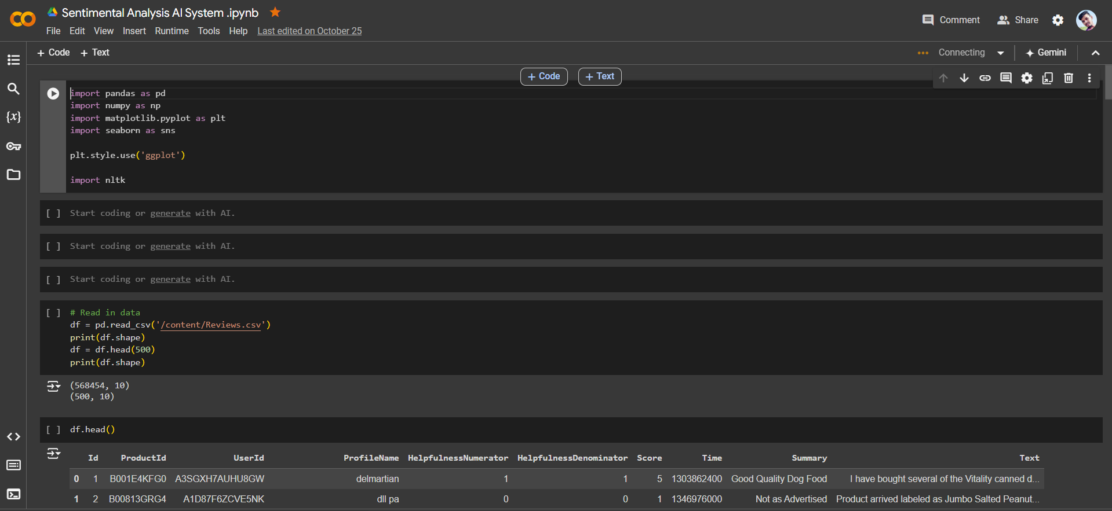
Video of Project Demo

Slide 9
Conclusion
This project effectively demonstrates the power of sentiment analysis by using VADER and RoBERTa models to analyze text sentiment. Through a combination of traditional and transformer-based approaches, we can achieve a comprehensive understanding of text emotions, valuable for applications like customer feedback analysis, social media monitoring, and market research. Future improvements may include fine-tuning models for specific domains and enhancing real-time processing capabilities, providing even deeper insights into sentiment dynamics.

Slide 10
Future Scope
Model Enhancement: Improve understanding of context and sarcasm.
Multilingual Support: Develop models for regional languages.
Real-Time Analysis: Implement sentiment tracking on social media.
User Feedback Integration: Update models based on user input.
Domain Applications: Explore uses in healthcare, finance, and education.
Tech Integration: Combine with AI tools like chatbots.
Data Privacy: Ensure compliance with privacy regulations.

Slide 11
Thank you!
Notes:
thank you very much for joining this PPT, keep learning.
11

